Slide 1
CV Maker – group 2
Markdown CV editor

Slide 2
Context
Develop metamodel for CVs:
Support any type of CV (as many types as possible);
Contain standardized sections;
Provide as much freedom as possible to the user;
Inspired by Europass and Ciência Vitae
Develop an editor for CVs complying with the metamodel:
Should be as visual as possible;
Must support everything that is possible to do with the metamodel;
Generate text documents from the models:
Use Markdown format;
Popular format on the web;
Multiple projects and tools to move from Markdown to other formats;

Slide 3
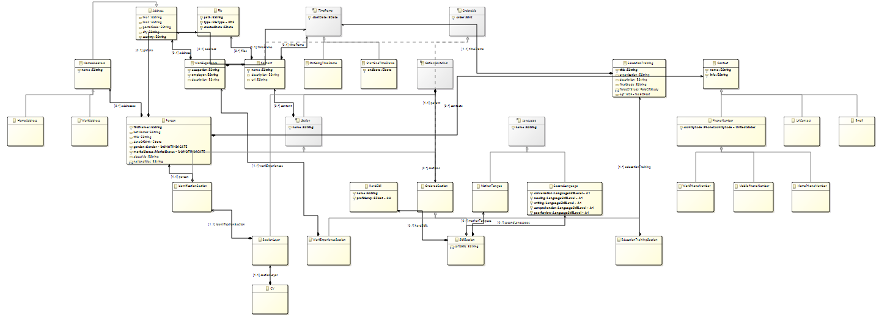
Metamodel overview

Slide 4
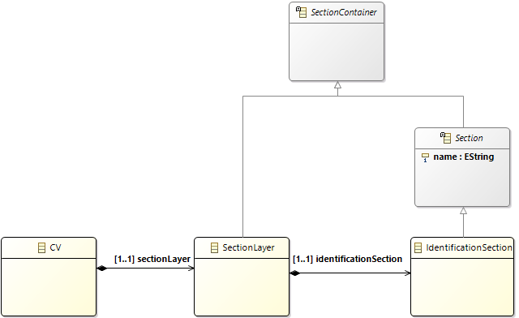
Metamodel concepts – Sections
The CVs are section-oriented
CV contains a SectionLayer which contains all sections.
Only the IdentificationSection is mandatory.
Section extends SectionContainer
A section can contain subsections

Slide 5
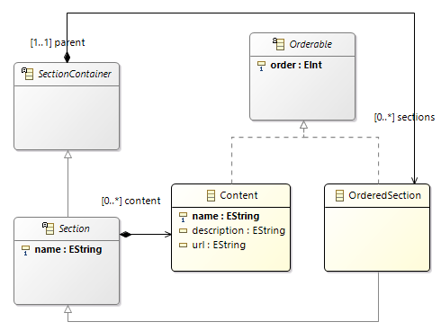
Metamodel concepts – Sections
Sections contain any number of subsections.
Can recurse indefinitely.
Subsections are sections and can contain sub-subsections.
Sections can’t contain themselves
Used OCL for constraint.
Sections and their content can be ordered.
Extend the Orderable class.

Slide 6
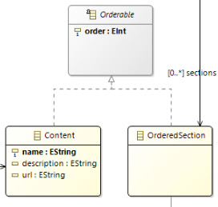
Metamodel concepts – Content ordering
Both section and the content inside them can be ordered.
They are ordered in relation to their siblings:
The children of a parent;
Single-level ordering;
The Identification section is not orderable:
It is always the first section on the document.
Predefined content is not manually orderable:
E.g., work experiences are always ordered from newest to oldest.
This is the standard and should make it easier for users when updating their CV.

Slide 7
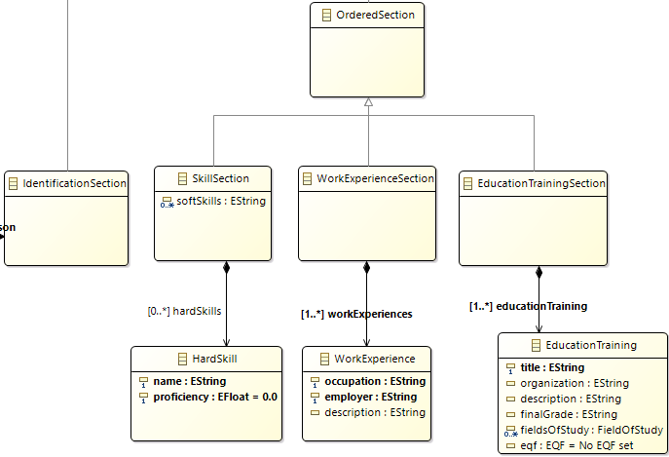
Metamodel concepts – Special Sections
There are a number of special sections:
Automatically includes prettifying elements;
Includes common information;
Shouldn’t add any new functionality.
Just makes common tasks easier.
More content can be added to instances of these sections;

Slide 8
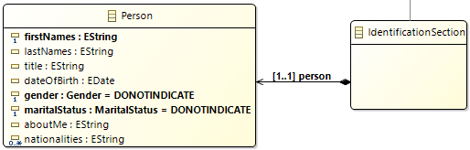
Metamodel concepts – Identification sections
The Identification section is the most special section:
Contains the personal information of the user;
This is the only mandatory section;
Can only reside at the top level;
Standardizes the identification of the user;

Slide 9
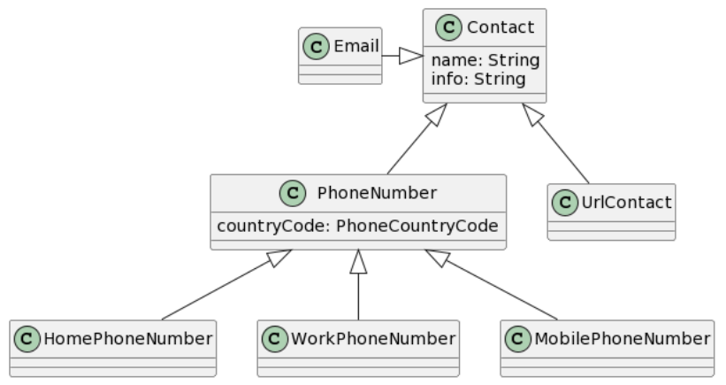
Metamodel concepts – Use of inheritance
Make extensive use of inheritance:
Decoration reasons;
Add more details if the user wants to;
Leads to some complex hierarchies in the metamodel
E.g., The contact information has a complex hierarchy that allows for dynamic icon changes in the editor.

Slide 10
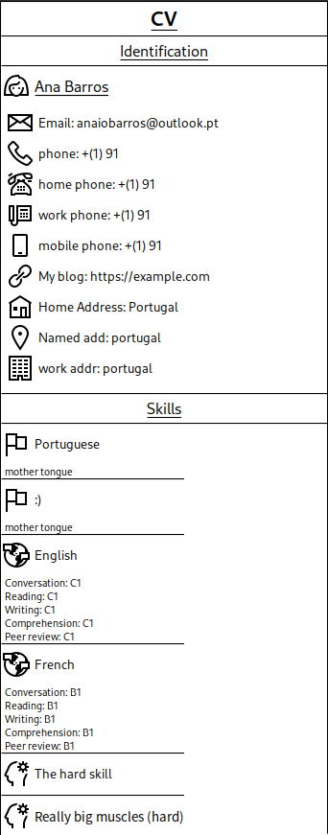
Visual representation
Editor that emulates the look of the final CV.
Has custom icons for most content;
Heavy usage of containers (instead of nodes)
Provides the square look;
Properties can be edited when clicking on the object;
Clicking objects shows the available context tools
e.g., for creating child objects;
Tools that can’t be used at a certain time are hidden;

Slide 11
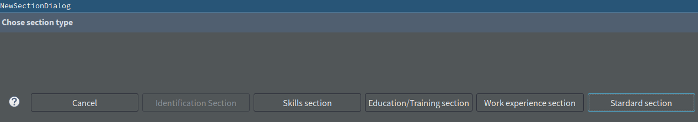
Visual representation – design choices
There is a Java service for obtaining the list of sections.
Containers cause problems when adding children:
E.g., subsections.
All sections need an empty/invisible node representing themselves;
When creating an object with multiple possible types, the user is presented with a dialogue box:

Slide 12
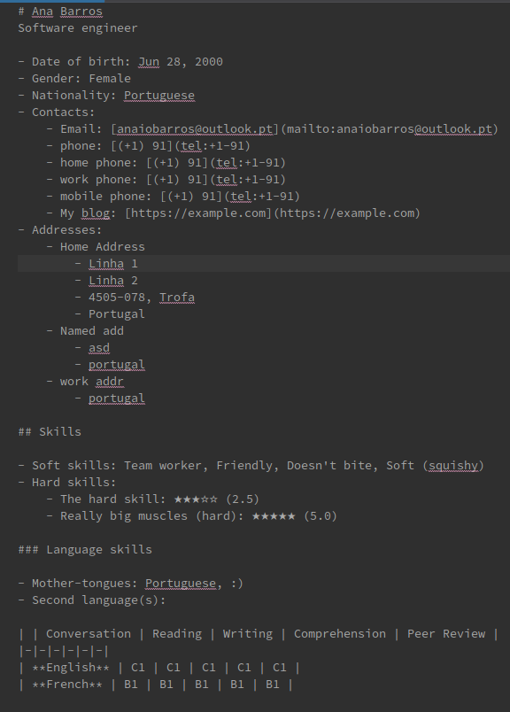
Textual representation
The textual representation follows the Markdown format:
Great for the web;
Easy to convert to other formats (e.g. PDF);
Inspired by markdown-cv:
Automatically generate and host a website for the CV on GitHub;
Easy to extend with new styles/variations;
The sections are just sections in Markdown:
Subsections are one-level lower section inside their parent;
Content is usually a series of bullet-points.

Slide 13
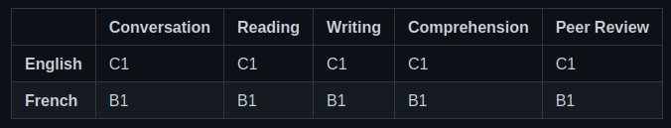
Textual representation – continued
Contact information shows as links with the appropriate prefix, e.g.:
Phone number: tel:+351-919191919
Email: mailto:example@example.com
Personal pages: https://example.com
Language skills are grouped in a table (see image below).
Contain the proficiency level for each component
Images are embedded in the textual representation
Other files are represented as links

Slide 14
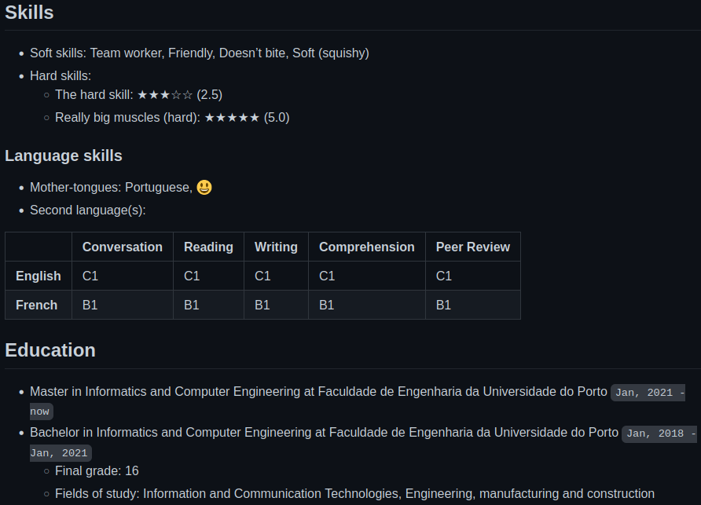
Textual representation – Java services
Java service for the PhoneNumber Enum:
The value of the Enum is the country-code;
Cannot access the value of the enum in Acceleo (only in Java);
Java service to format dates into a more readable format:
yyyy-mm-dd
Java service to show the HardSkill skill level as a sequence of 5-stars:
Similar to the 5-star rating system (popular in ecommerce);
Shows the proficiency level from 0.0 to 5.0;

Slide 15
Examples
Textual and Graphical representations

Slide 16
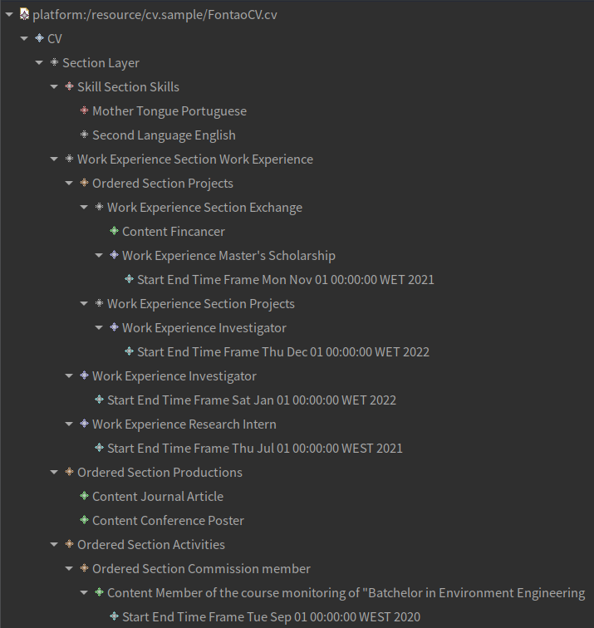
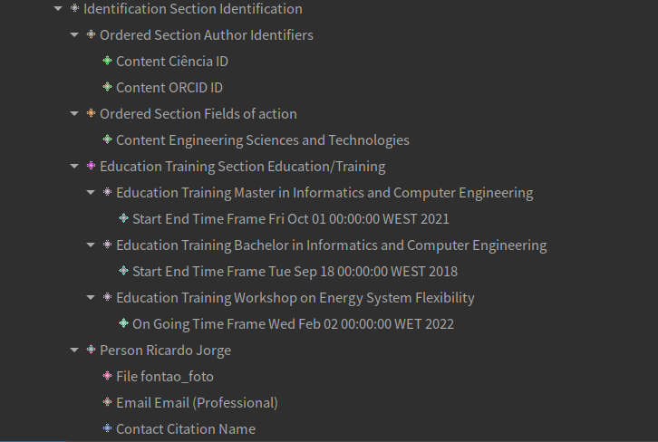
Ricardo Fontão’s CV - model instance

Slide 17
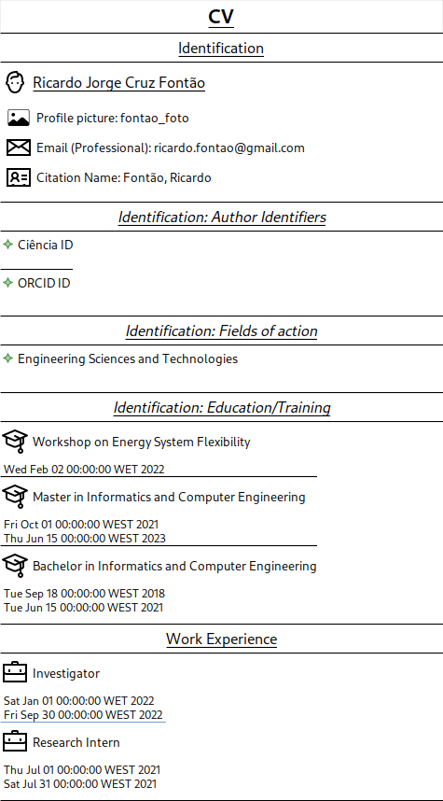
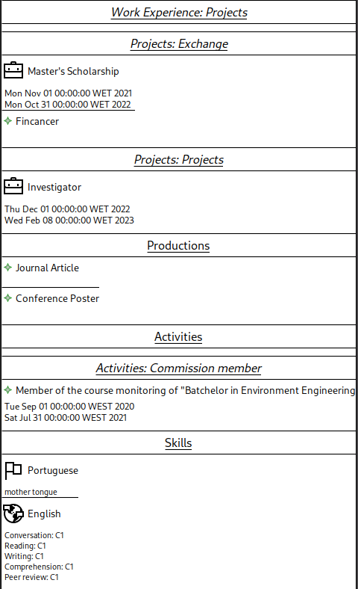
Ricardo Fontão’s CV
Graphical Representation

Slide 18
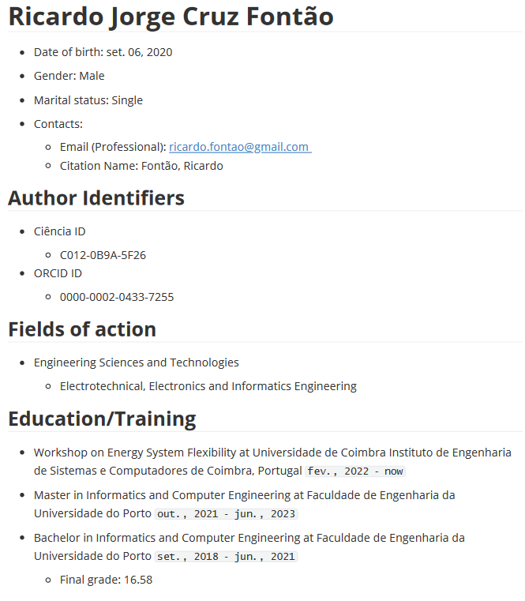
Ricardo Fontão’s CV
Textual Representation

Slide 19
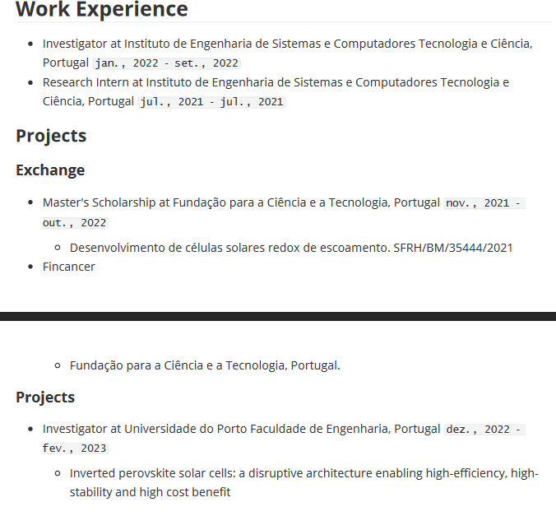
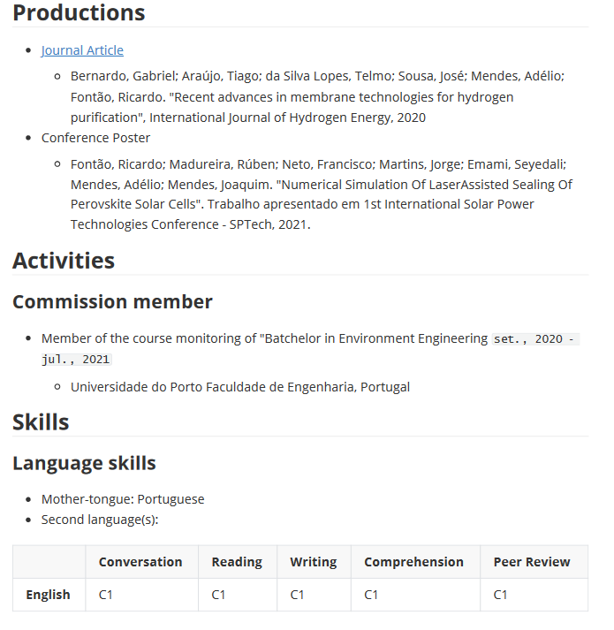

Slide 20
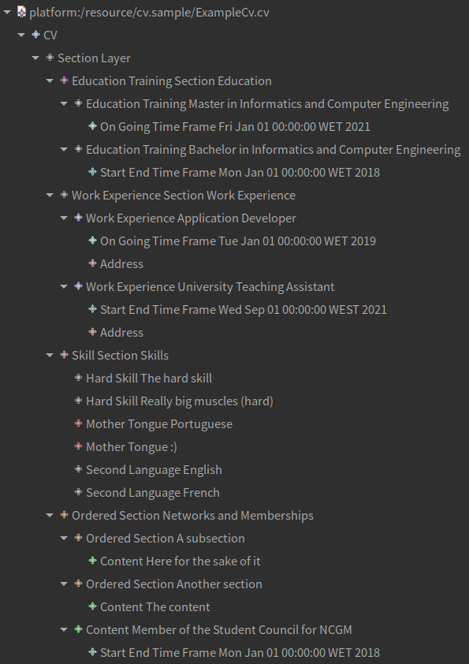
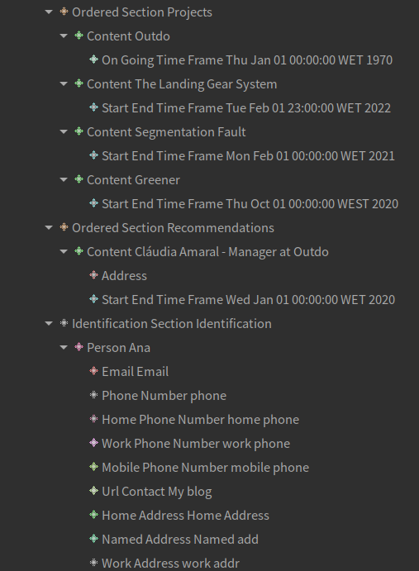
Ana Barros’ CV
Model instance

Slide 21

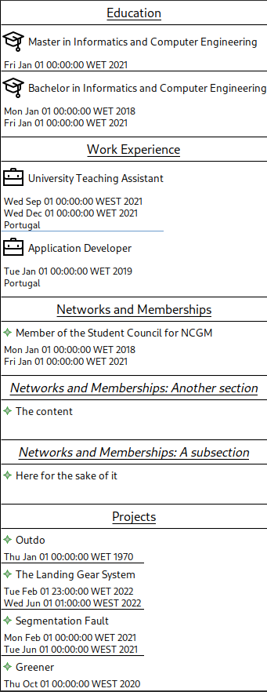
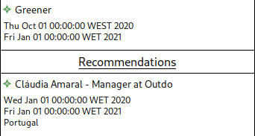
Ana Barros’ CV
Graphical representation

Slide 22
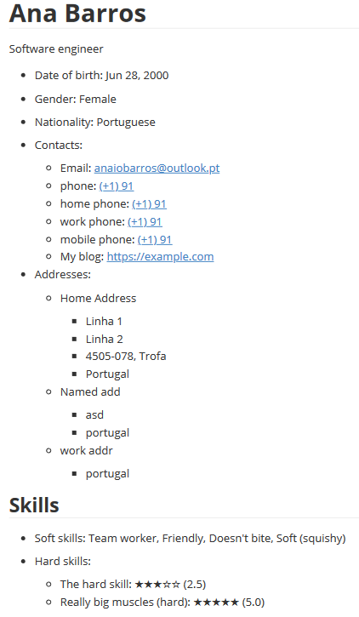
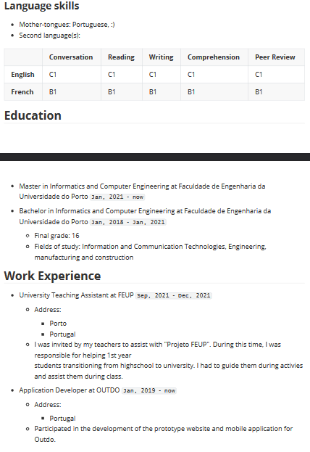
Ana Barros’ CV
Textual representation

Slide 23
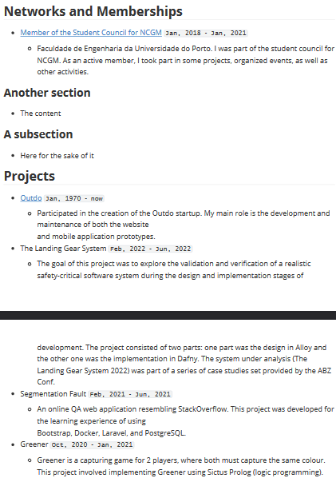
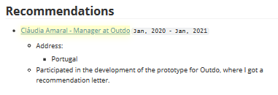

Slide 24
Thank you for listening
A presentation by:
Ana Inês Oliveira de Barros – up201806593@fe.up.pt
João Alexandre Lobo Cardoso – up201806531@fe.up.pt
João de Jesus Costa – up201806560@fe.up.pt

